Slide 1
Internal DSLs
by: mike suarez

Slide 2
Domain-specific language
a computer programming language of limited expressiveness focused on a particular domain

Slide 3
External DSL
ul#menu {
height: 38px;
width: 100%;
list-style-type: none;
overflow: hidden;
background: transparent url(bg.png) repeat-x;
border-top: 2px solid #999;
border-bottom: 2px solid #999;
font-size: 1.4em;
line-height: 1.2em;
}

Slide 4
Internal DSL
var filesOlderThan5Days =
from file in Directory.GetFiles(@"c:\temp") where File.GetLastWriteTime(file) > DateTime.Now.AddDays(-5) orderby file select file;

Slide 5
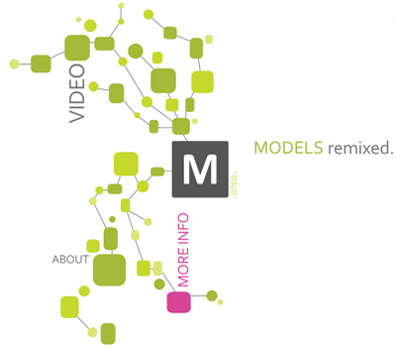
Language Workbench

Slide 6
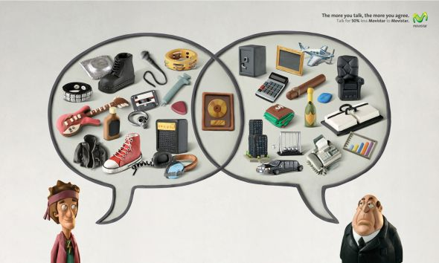
Communication

Slide 7

Developer Productivity
Autocomplete & Intellisense
Refactoring
Compile check

Slide 8


Do’s & Don’ts
Do seek clarity for the reader
Do use the Ubiquitous Language
Do use Conventions
Don’t shoot for natural language
Don’t finish it

Slide 9
Command-Query & Fluent API
var p = new Processor(
2, 2500, Processor.Type.i386);
var d1 = new Disk(
150, Disk.UNKNOWN_SPEED, null);
var d2 = new Disk(
75, 7200, Disk.Interface.SATA);
return new Computer(p, d1, d2);
computer()
.processor()
.cores(2)
.speed(2500)
.i386()
.disk()
.size(150)
.disk()
.size(75)
.speed(7200)
.sata()
.end();

Slide 10
NHibernate & Fluent NHibernate
<hibernate-mapping xmlns="urn:nhibernate-mapping-2.2"
namespace="QuickStart" assembly="QuickStart">
<class name="Cat" table="Cat">
<id name="Id">
<generator class="identity" />
</id>
<property name="Name">
<column name="Name" length="16" not-null="true" />
</property>
<property name="Sex" />
<many-to-one name="Mate" />
<bag name="Kittens">
<key column="mother_id" />
<one-to-many class="Cat" />
</bag>
</class>
</hibernate-mapping>
public class CatMap : ClassMap<Cat>
{
public CatMap()
{
Id(x => x.Id);
Map(x => x.Name)
.Length(16)
.Not.Nullable();
Map(x => x.Sex);
References(x => x.Mate);
HasMany(x => x.Kittens);
}
}

Slide 11
SDF & Fluent SD
<web-service-generator> <entity name="Person“ source-type="UltimateSoftware.
ObjectModel.Objects.Person,
UltimateSoftware.ObjectModel“ mapping-file="EmployeePerson"> <facade type="UltimateSoftware.ObjectModel.
Facade.EmployeeSetup,
UltimateSoftware.ObjectModel.Facade"> <get-method name="GetEmployeePerson"> <parameter-mappings> <mapping argument-name="EEID"
argument-type="System.String"
property-name="EEID"/> </parameter-mappings> </get-method> </facade> <properties> <key-property source-name="EEID"
type="System.String" column="EmpPers.eepEEID" /> </properties> </entity> </web-service-generator>
public class PersonServiceDefinition :
ServiceDefinition<Person> { public PersonServiceDefinition() { Name("Person") .MappingFile("EmployeePerson") .Key<string>("EEID", "Id") .Facade<EmployeeSetup>(f => f .GetMethod(m => m
.GetEmployeePerson(
Arg<string>("EEID"))) .SetMethod(m => m
.SetEmployeePerson(null))); } }

Slide 12

Language Cacophony

Slide 13

Cost of Building

Slide 14
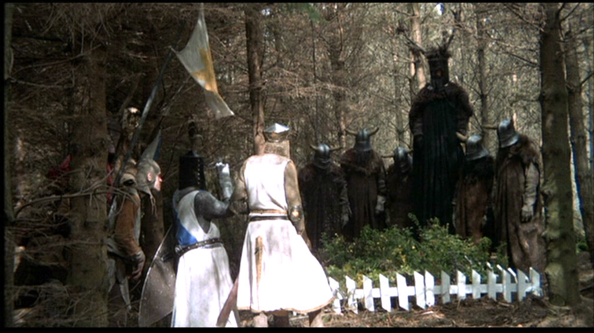
Ghetto Language
Ni! ni!! Ni ni
Ni ni ni
NI
ni! NI ni
ni ni!

Slide 15
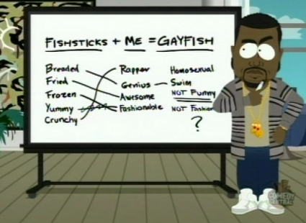
Blinkered Abstraction

Slide 16
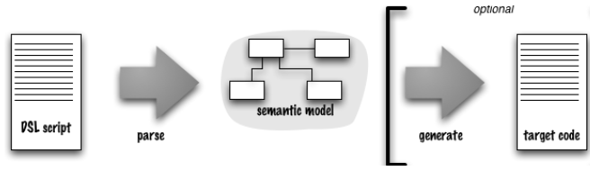
Architecture of DSL Processing

Slide 17
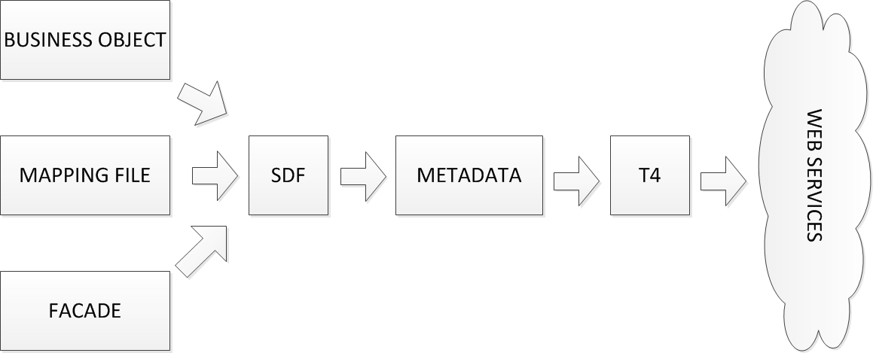
US.Foundation.Services

Slide 18
Function Sequence
A combination of function calls as a sequence of statements.
computer();
processor();
cores(2);
speed(2500);
i386();
disk();
size(150);
disk();
size(75);
speed(7200);
sata();

Slide 19
Nested Function
Compose functions by nesting function calls as arguments of other calls.
Facade<EmployeeSetup>(f => f .GetMethod(m => m
.GetEmployeeAddress( Arg<string>("EEID"), Arg<string>("EEID"))) .SetMethod(m => m
.SetEmployeeAddress(null)));

Slide 20
Method Chaining
Make modifier methods return the host object, so that multiple modifiers can be invoked in a single expression.
Name("Contact") .MappingFile("EmployeeContact") .Property(p => p.Identification.FirstName, "FirstName") .Property(p => p.Identification.LastName, "LastName") .Property(p => p.CobraInformation.Status.Code, "COBRAStatus") .Property(p => p.ContactInformation.HomePhone.Number, "HomePhone") .Key<string>("EEID", "EmployeeId") .Key(k => k.SystemID)

Slide 21
Object Scoping
Place the DSL script so that bare references will resolve to a single object.
public class PersonServiceDefinition :
ServiceDefinition<Person> { public PersonServiceDefinition() { ... } }

Slide 22
More…
Closure // x => x.f()
Literal List // f(params object[] args)
Dynamic Reception // dynamic
Annotation // [Attribute]
Literal Extension // f(this object x)

Slide 23
?

